Slide 1
Brief History of Sequencing

Slide 2
Learning Objectives
To learn a brief history of genome sequencing technologies
To become familiar with genome assembly strategies

Slide 3
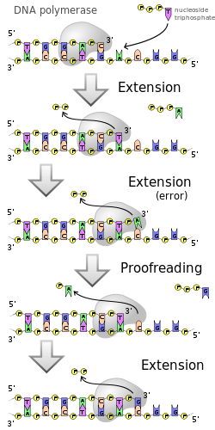
DNA Replication
DNA polymerase is an enzyme that works by incorporating new nucleotides at the 3’ end of an existing strand of DNA (primer) complementary to those existing on the opposite strand (template)
DNA polymerases in vivo typically have error rates less than one in 10⁷
Wikipedia, “DNA_Replication”, September 3rd 2013

Slide 4
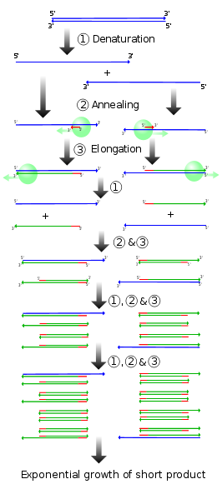
Polymerase Chain Reaction (PCR)
Method developed by Kary Mullis in 1983 to amplify DNA
Awarded Nobel Prize in 1993
Requires a thermostable DNA polymerase, dNTPs, and complementary primers bounding a sequence of interest
Taq polymerase is most often used, however it lacks 3’ to 5’ proofreading ability and thus has an error rate closer to 1 in 10⁴
Alternating denaturing, annealing, and elongation steps through temperature cycling
Wikipedia, “PCR”, September 26th 2012

Slide 5
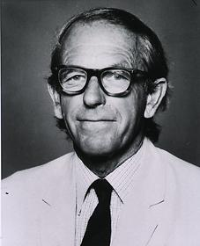
Frederick Sanger
Pioneer in the sequencing of DNA, RNA, and amino acid peptide chains
Only person (to date) to have been awarded two Nobel prizes in Chemistry
One of 4 to have been awarded two in any field
Eponymous namesake of Wellcome Trust Sanger Institute (formerly the Sanger Centre)
Frederick Sanger
National Library of Medicine

Slide 6
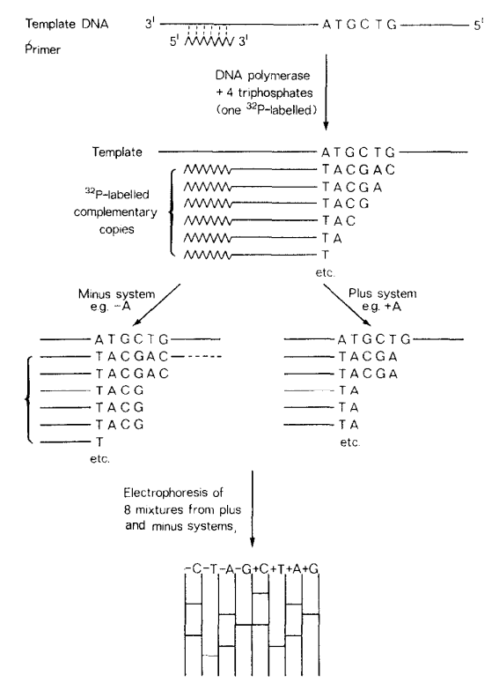
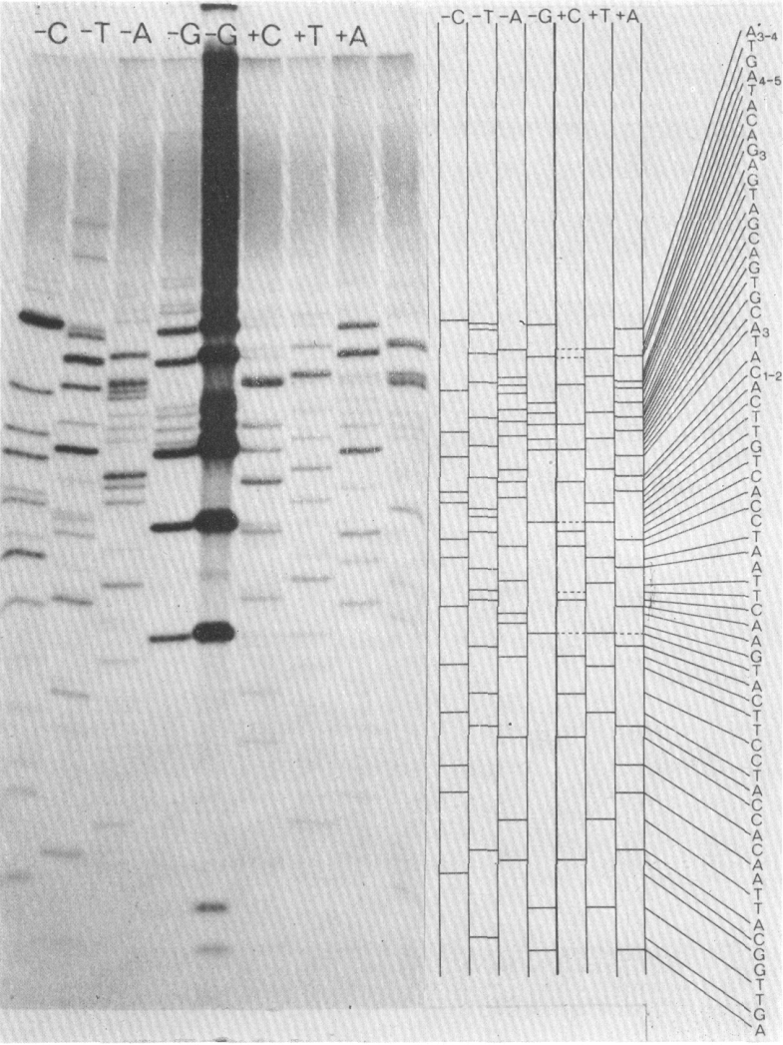
“Plus and Minus” Method
“sequencing by synthesis”
Applicable to single stranded DNA (ssDNA) only!
Sanger F and Coulson AR (1975) J. Mol. Biol., 94, pp. 441-448

Slide 7
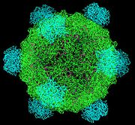
First DNA Genome Sequenced
Bacteriophage φ-X174
5,386 base pairs, ssDNA
Contains 11 proteins consisting of 1986 amino acids
With 3bp required for 1 amino acid that would require at least 5,958 bp of sequence
φ-X174 thus showed the first example of overlapping genes
“The most striking feature of the ϕX DNA sequence is the way in which the various functions of the genome are compressed within the 5,375 nucleotides” –F. Sanger, Nature, 1977
Wikipedia, “Phi_X_174”, September 26th 2012

Slide 8
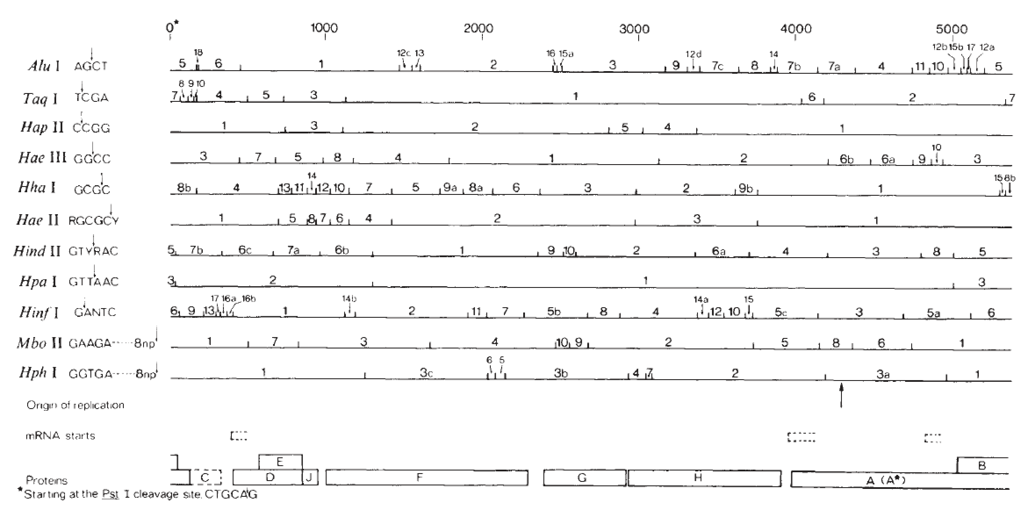
Fragment Map of φ-X174
Various restriction enzymes used for creating priming sites
Sanger F et al (1977) Nature, 265, pp. 687-695

Slide 9
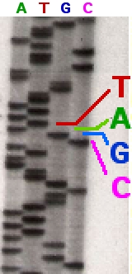
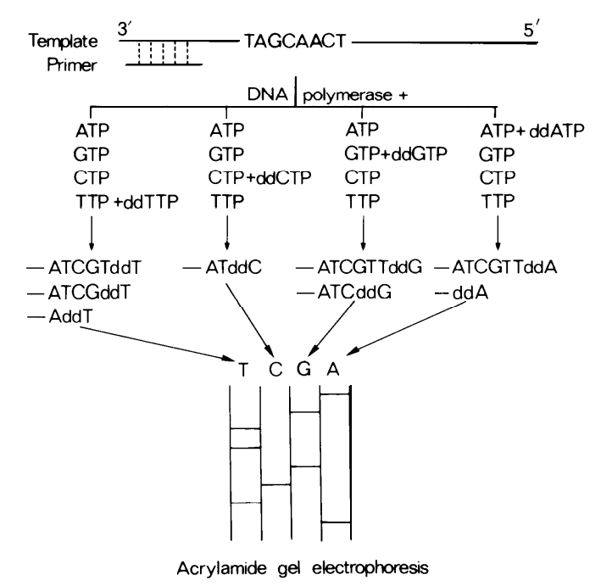
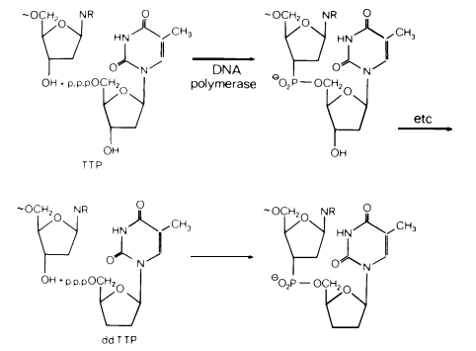
Dideoxy “Sanger” method of DNA sequencing
“sequencing by synthesis”
Sanger F, 1980, Nobel Lecture, http://www.nobelprize.org
Wikipedia, “Sanger Sequencing”, September 26th 2012

Slide 10
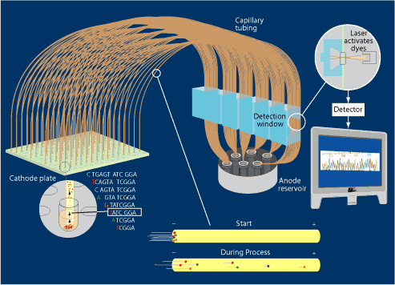
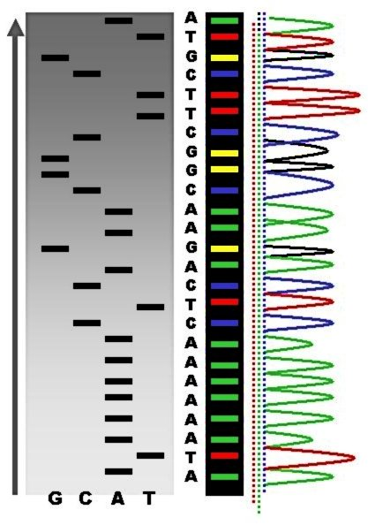
Improvements to Sanger Method
Modern Sanger sequencing is automated using dye-termination, with each dideoxynucleotide labeled with a different fluorescent marker
These can then be separated by capillary electrophoresis and identified using a laser
DOE JGI, http://www.jgi.doe.gov/sequencing/education/how/how_10.html, September 26th 2012
Wikipedia, “Sanger Sequencing”, September 26th 2012

Slide 11
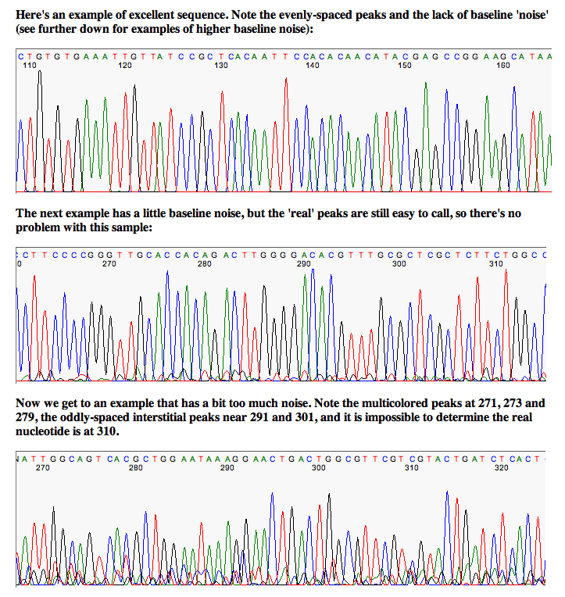
Sequence Chromatograms
Capillary-based Sanger sequencing reports per-base fluorescent values for each position
Errors in base-calling can occur when multiple peaks are present.
Phred is a base-calling program that assesses this error and assigns a per-base quality “Phred score” that indicates the probability that the base called is wrong
University of Michigan Sequence Core, http://seqcore.brcf.med.umich.edu/

Slide 12
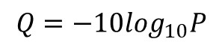
Phred –Base Calling and Early Quality Scoring
General Scheme for Base Calling (see Ewing et al for more details):
Phase 1: Locating Predicted Peaks
Phase 2: Locating Observed Peaks
Phase 3: Matching Observed and Predicted Peaks
Phase 4: Finding Missed Peaks
Quality Assessment:
We did this by considering for each trace the segment of the cosmid sequence that is aligned to the ABI-called read by cross match, the segment of the cosmid that is aligned to the phred-called read, and then taking the intersection of these two segments (this intersection is called the set of jointly alignable bases for the trace). Discrepancies inside this segment were tabulated; those outside it were ignored. Discrepancies were classified as substitutions (not counting Ns), Ns, insertions, and deletions, and tabulated in 100-base intervals with respect to position in the read sequence. The error rate for a particular error type in a particular 100-base interval in a data set is computed as the total number of errors of that type in that interval, divided by the total number of jointly alignable bases in that interval in the data set
Quality Scores are scaled logarithmically:
where P is the base-calling error probability
$$Q=−10\log_{10}P$$
Ewing, B et al (1998), Genome Res., 8(3), pp. 175-85

Slide 13
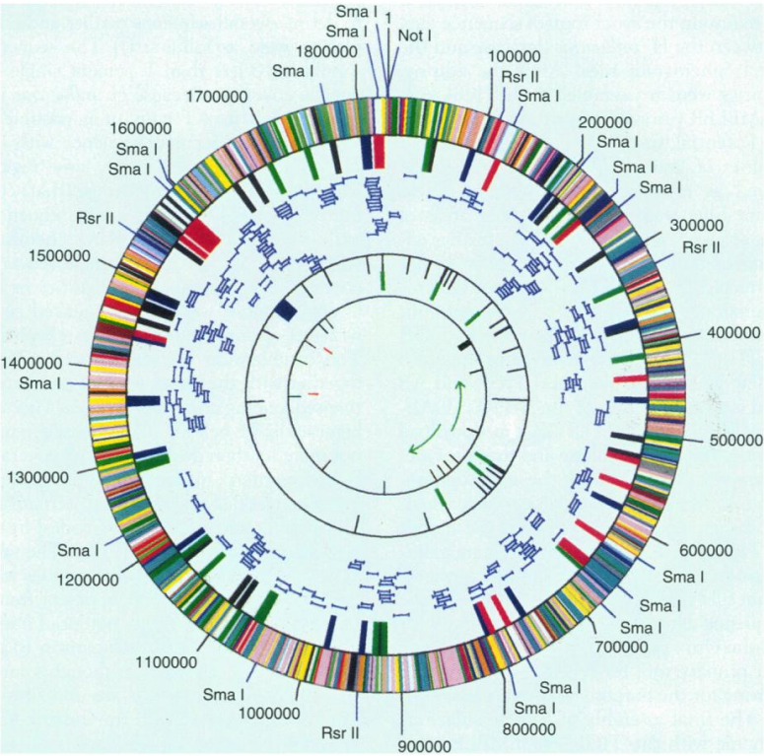
First Genome of a Free Living Organism
Haemophilus influenzae
Sequenced in 1995 by Craig Venter and colleagues at TIGR
1,830,137 bp
Why?
Typical bacterial genome size
Similar %GC as human
No existing physical map
Availability of high-quality DNA libraries
Fleischmann, RD et al (1995), Science, 269(5223), pp. 496-512

Slide 14
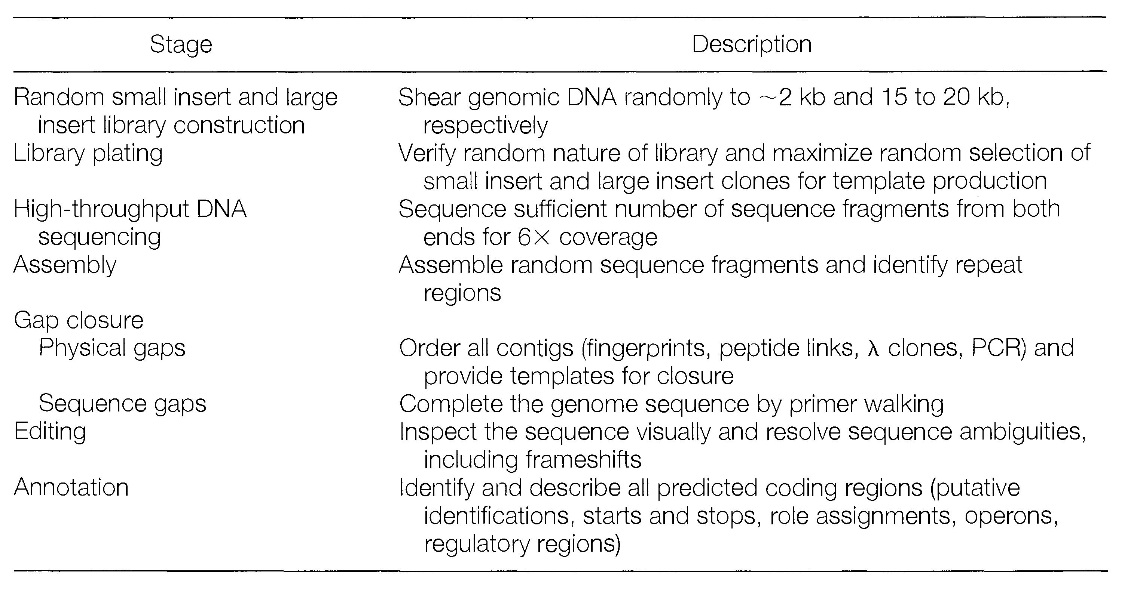
H. Influenzae sequencing strategy
Fleischmann, RD et al (1995), Science, 269(5223), pp. 496-512

Slide 15
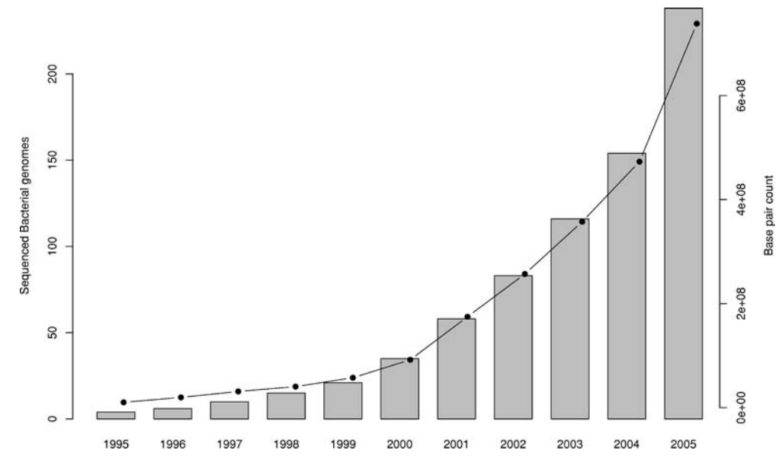
Sequenced Bacterial Genomes (1st gen)
Binnewies, TT et al (2006), Funct Integr Genomics, 6, pp. 165-185

Slide 16
Sequencing Eukaryotes
Common Model Organisms
1996 - Saccharomyces cerevisiae (baker’s yeast) was the first eukaryotic genome sequenced
1998 – Caenorhabditis elegans (worm) was the first multicellular eukaryote sequenced
2000 – Arabidopsis thaliana (thale cress) was the first plant sequenced
2000 – Drosophila melanogaster (fruit fly) sequenced

Slide 17
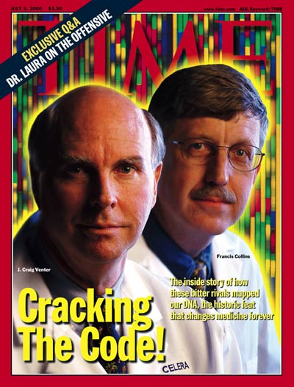
Sequencing the Human Genome
Race between public and private initiatives
The Human Genome Project (HGP) was an international, public consortium that started in 1990 and was primarily led by Francis Collins
Eventual Cost: $2.7 Billion
Celera Genomics was a private corporation headed by Craig Venter that started in 1998
Eventual Cost: $300 Million
Both initiatives released initial drafts of the human genome in 2001

Slide 18

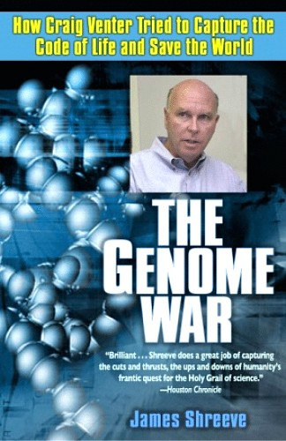
The Human Genome: A Drama in Two Parts
Further reading, if interested:

Slide 19
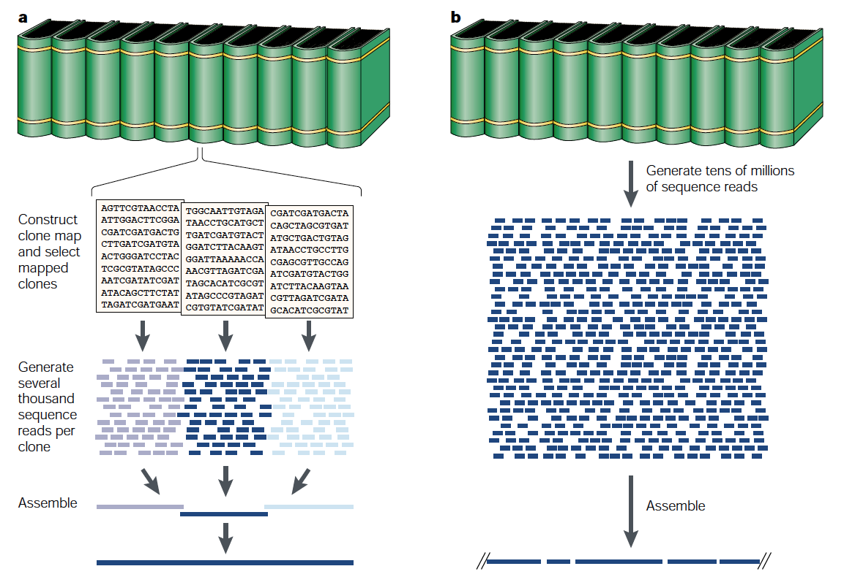
Whole Genome Sequencing Strategies
Clone-by-Clone Sequencing
Whole Genome Shotgun (WGS) Sequencing
HGP
Celera
clone-by-clone
whole genome shotgun
Green, ED (2001), Nat. Rev. Genet., 3, pp. 573-583

Slide 20
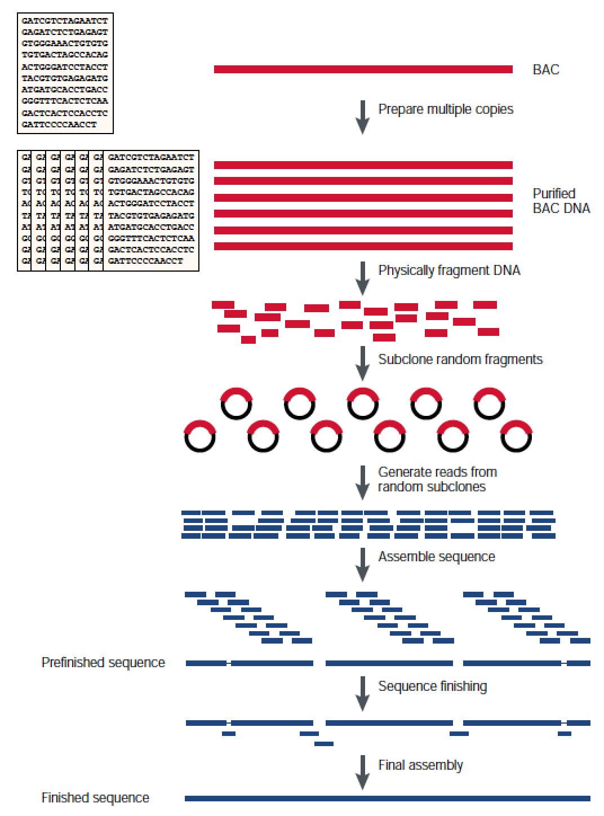
Clone-by-clone Approach
Green, ED (2001), Nat. Rev. Genet., 3, pp. 573-583

Slide 21
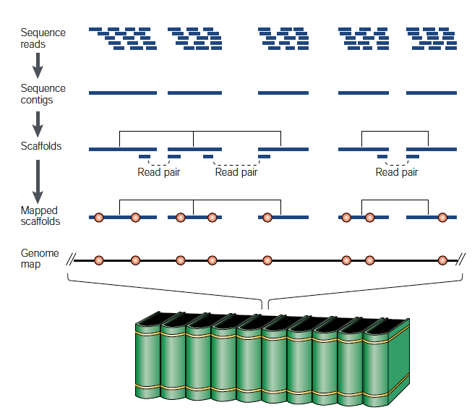
Whole Genome Shotgun Approach
Green, ED (2001), Nat. Rev. Genet., 3, pp. 573-583

Slide 22
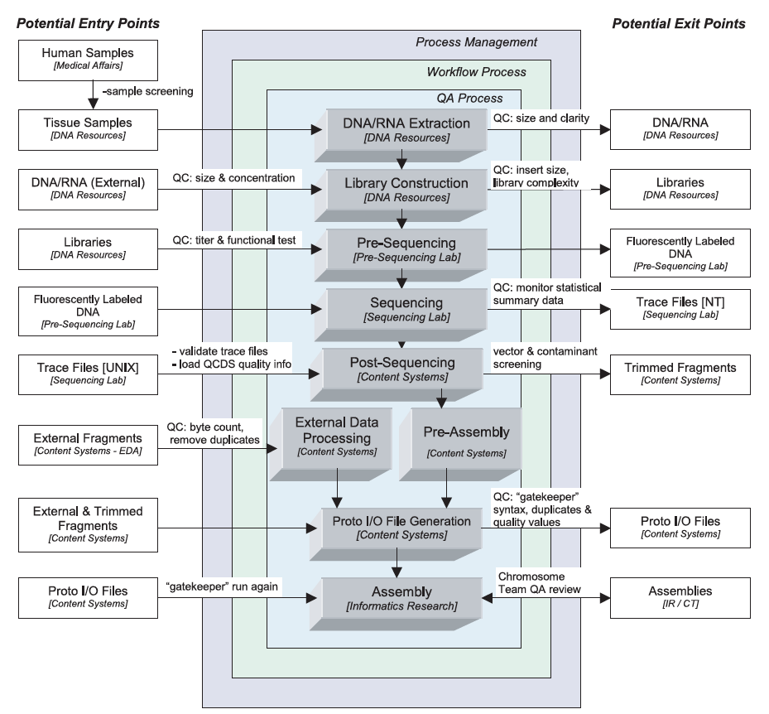
Celera Sequencing Pipeline
Venter, JC (2001), Science, 291, pp. 1304-1351

Slide 23
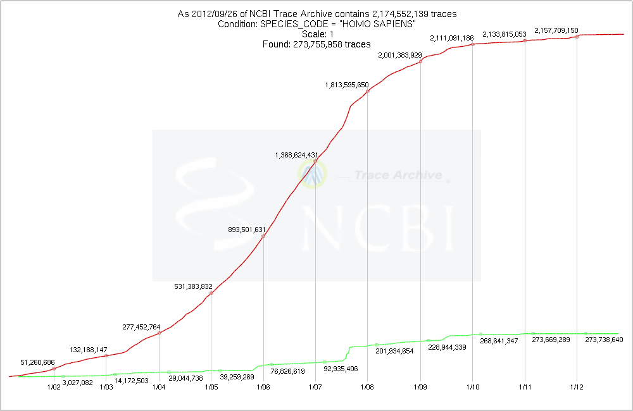
NCBI Trace Archive
Repository for DNA sequence traces
http://www.ncbi.nlm.nih.gov/Traces/trace.cgi
all species
humans

